Slide 1

Thesis Presentation
Graph-based Website Embeddings To Optimize Digital Ad Campaigns
By
Vyom Pankajkumar Bhatt
A thesis submitted in fulfilment of the
requirements for the award of the degree of
Master of Science in Data Science
Liverpool John Moores University (LJMU)
JULY 2020

Slide 2
Presentation Content
Topics
Motivation & Background
Problem Statement
Aim & Objectives
Literature Review
Methodology
Analysis
Results
Conclusion & Recommendations
Contribution to Knowledge
Limitations & Future Recommendations

Slide 3

Motivation & Background
Digital Advertising
Advertising over banners/videos over the internet
Programmatic Ad Buying allows purchasing relevant ad slots to reach the right user depending on targeting strategy
2 broad types of targeting strategies:
Cookie-based (Audience) Targeting
Contextual (Website) Targeting
Motivation
Cookie-based targeting is limited in scope due to stricter government regulations
Contextual targeting strategies are increasingly in demand - requiring a need to have more sophisticated data-driven strategies
The idea is to segment relevant websites, that can be used for targeting across different advertisers. Every segment of websites should hold websites that are closely related to each other, which can therefore be targeted in form of a whitelist for an ad campaign.

Slide 4
Problem Statement
The problem at hand is
to produce a data-driven contextual targeting solution that can be used for optimizing the targeting in digital advertising campaigns.

Slide 5
Aim & Objectives
Aim
This research aims to use graph-based geometric deep learning techniques on a click-stream dataset to generate clusters of websites that can be used for the optimization of digital campaigns.
Objectives
To represent the websites in the form of a graph structure.
To model website embeddings from the graph using geometric deep learning techniques.
To generate clusters of relevant websites using the embeddings.
To design a relevant criterion and evaluate the various techniques used in the methodology to identify the best performing technique.

Slide 6

Literature Review
Learnings from the Literature Review
Government regulations, such as the GDPR, have discouraged use of web cookies and other PII data.
Gaps existing in the current methods of contextual targeting
The click-stream web traffic data from Indiana University was identified as the dataset for this study.
An exhaustive research done on the analytical aspects implemented in this study to identify the most suitable architecture for different models:
Graph Representation of Data
Clustering
Generating Embeddings from Graphs
Dimensionality Reduction
Algorithms decided for this study: Node2vec for generating embeddings, dimensionality reduction using PCA and t-SNE, clustering using linear and non-linear techniques
Website Embeddings refer to the vector representation of the websites that explains the relationship between them

Slide 7
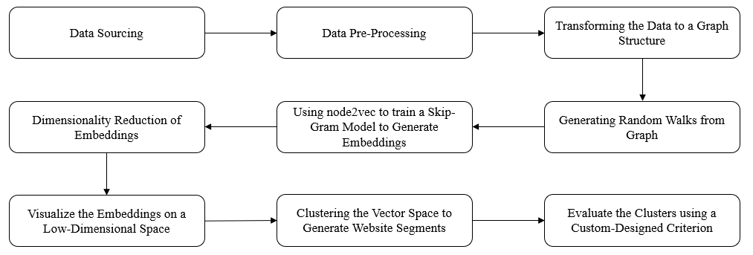
Methodology I
Sample of Dataset
Referrer Website | Destination Website | Count of Users
youtube.com | google.com | 212,049
huffingtonpost.com | facebook.com | 20,909
msn.com | bing.com | 13,935
tvguide.com | facebook.com | 5,636
people.com | celebrity-babies.com | 1,116
Dataset with 3 columns holding information on the number of common users shared between any 2 websites
Methodology Flowchart
The chart explains the analytical techniques implemented on the dataset to achieve the desired objectives

Slide 8
Methodology II
Models and Architectures
Application | Algorithms | Architecture (Hyperparameters Tuned)
Neural Network for Generating Embeddings from the Graph | Node2Vec | Node2Vec Dimensions: 10, 20, 50
Dimensionality Reduction | None | -
 | PCA | Components that explain 90% variance
 | T-SNE | Components: 2, 5, 10, 20, 50
Clustering | K-means Clustering | No. of Clusters: [5 to 50] in steps of 5
 | Hierarchical Clustering | No. of Clusters: [5 to 50] in steps of 5
 | DBSCAN | Eps: [0.1, 0.2, 0.5, 1, 2, 5] Min Samples: [3, 5, 10, 20, 50, 100]

Slide 9


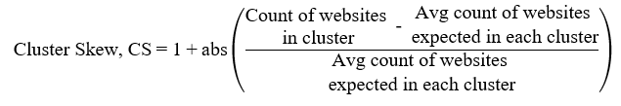


Methodology III
Evaluation Criterion
After generating the clusters using the different architectures, the quality of the clusters needs to be evaluated to identify the best set of models.
1
2
3
4
CCI ranges between {0, 1}
A higher CCI score corresponds to a cluster with websites very similar to each other (preferable!)

Slide 10
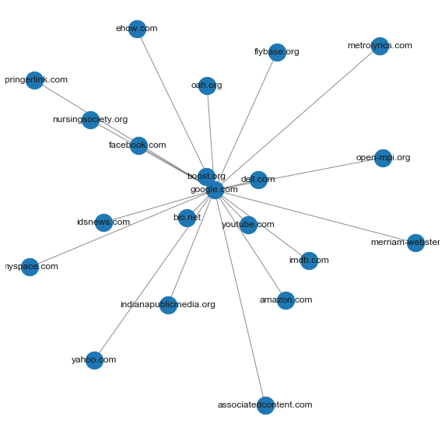
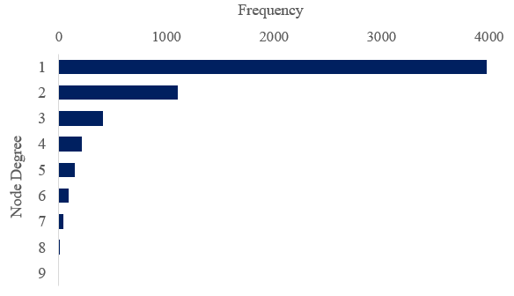
Analysis
Transforming to Graph Structure
EDA to Understand the Graph Structure
25%
of all the website hits in the dataset belong to 3 websites:
google.com, youtube.com, facebook.com
Feature | Value
Number of Nodes | 5,992
Number of Edges | 8,412
Graph Density | 0.047%
Graph Diameter | 38,747
Graph Degree Centrality | 0.0062%
Average Node Degree | 1
The graph is sparsely connected and exhibits very little degree centrality, which is ideal as sparser node relationships can be captured!
Node Degree Distribution
Over 60% of the nodes have only 1 other connected node, hence the sparse graph density!
A sample sub-graph showing websites connected to google.com

Slide 11
Results I
Node2Vec Dimensions | Dimensionality Reduction Technique | Clustering Technique | Optimal Number of Clusters | CCI Score
10 | None | K-Means | 50 | 0.286
 |  | Hierarchical | 50 | 0.305
 |  | DBSCAN | 2 | 0.410
 | PCA | K-Means | 40 | 0.327
 |  | Hierarchical | 50 | 0.285
 |  | DBSCAN | 5 | 0.200
 | t-SNE | K-Means | 45 | 0.381
 |  | Hierarchical | 50 | 0.388
 |  | DBSCAN | 1 | 0.000
20 | None | K-Means | 50 | 0.295
 |  | Hierarchical | 40 | 0.372
 |  | DBSCAN | 2 | 0.375
 | PCA | K-Means | 40 | 0.335
 |  | Hierarchical | 50 | 0.336
 |  | DBSCAN | 2 | 0.403
 | t-SNE | K-Means | 45 | 0.433
 |  | Hierarchical | 50 | 0.383
 |  | DBSCAN | 1 | 0.000
50 | None | K-Means | 50 | 0.260
 |  | Hierarchical | 50 | 0.340
 |  | DBSCAN | 5 | 0.000
 | PCA | K-Means | 35 | 0.327
 |  | Hierarchical | 50 | 0.340
 |  | DBSCAN | 2 | 0.379
 | t-SNE | K-Means | 45 | 0.368
 |  | Hierarchical | 50 | 0.351
 |  | DBSCAN | 1 | 0.000
The best performing set of models:
20 dimension Node2Vec model
T-SNE dimensionality reduction
K-means clustering (with 45 segments of websites)

Slide 12
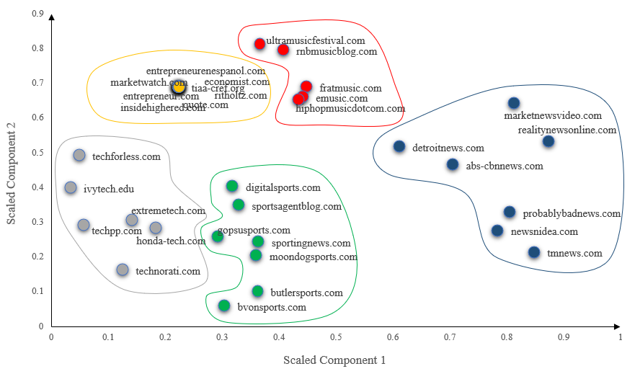

Results II
Having generated the embeddings, let’s intuitively identify how well the neural network is able to represent the websites on a vector space!
1
Identify the 11 closest websites to the economist.com on the vector space. The websites are all relevant to each other, belonging to the finance/business/economy categories.
2
A set of websites belonging to 5 different categories are visualized on a 2-D vector space.

Slide 13
Conclusions and Discussions
All the objectives achieved throughout this study:
To represent the websites in the form of a graph structure.
To model website embeddings from the graph using geometric deep learning techniques.
To generate clusters of relevant websites using the embeddings.
To design a relevant criterion and evaluate the various techniques used in the methodology to identify the best performing technique.
Application of Methodology/Results in Digital Advertising
Fills existing gaps in the lacking contextual targeting techniques.
Doesn’t require cookie-data, hence isn’t in violation of any government regulations
Websites have been clustered according to the relationships they exhibit. These clusters of websites can be used for targeting/optimizing an ad campaign contextually in a data-driven manner.

Slide 14
Contribution to Knowledge
Literature Review presents and surveys the existing scenario of digital ad targeting
Contribution towards available contextual targeting capabilities in a data-driven manner
Identifying a new application for the researched geometric deep learning techniques in a new domain
Designed a custom evaluation criterion that can be expanded upon by other researchers
The code for this study written from scratch, can be referenced by other researchers studying in relevant domains

Slide 15



Limitations and Future Recommendations
Limitations
Computational Resources
Richer Open-Source Dataset
Duration of the study
Future Recommendations
Using a different dataset with more datapoints
Performing other extended applications apart from contextual targeting:
Predicting next website that a user visits
Using website embeddings for feature encoding in machine learning problems
Evaluating performance of other geometric deep learning techniques on the dataset

Slide 16
Thank You

